Slide 1




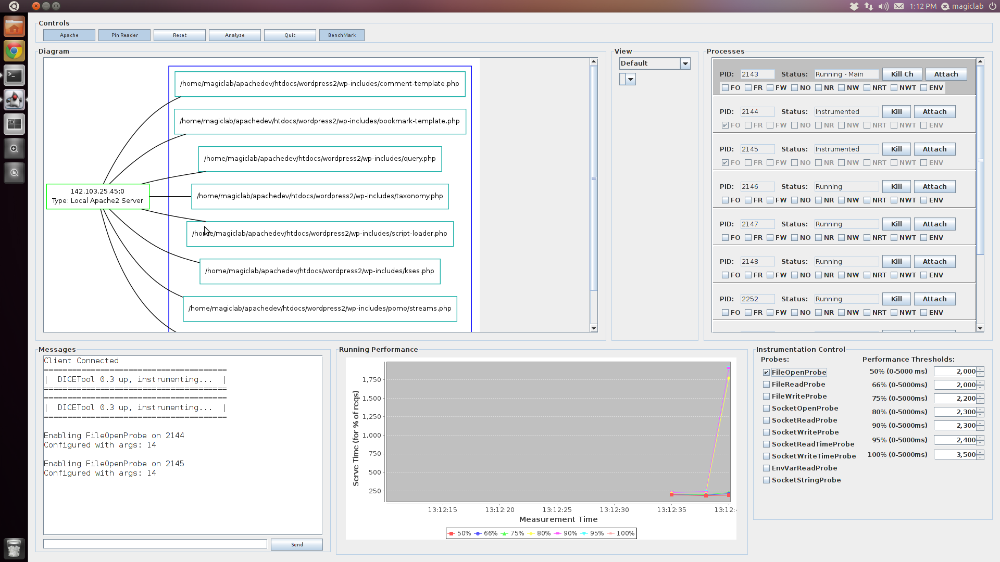
DICETool
oo
Friendly Dynamic Instrumentation for Configuration Extraction
Lee Beckman
Rodger Lea
Ebrahim Bagheri
Nima Kaviani
oo
DICETool uses the Intel Pin framework to perform Dynamic Binary Instrumentation (analyzing and adding to compiled application code as it executes), which allows it to be very general, able to target almost any Linux application. DICETool focuses on supporting the analysis of large applications with many components, and importantly offers a platform to easily develop and use custom, dynamically controllable probes. Probes collection various forms of data, optionally perform analyses, and pass the data on for higher-level tools. A collection of probes has already been developed.
Why?
What?
Knowing the resources an application uses and how it stores configuration is useful when migrating it, especially if the application is massive. Dynamic Binary Instrumentation has been used to monitor application components as they run, automatically collecting data about them and their interactions with other components that would otherwise be difficult to obtain. Performing this instrumentation, however, can be a difficult and tedious process, involving working with finicky, low-level APIs not designed for ease of use.
Some
Probes
Probes (note how great probes are) and Use of Output
System Overview
Instrumentation
…Request Method: G…
SocketOpenProbe
1
Start with a service to instrument, in this case the Apache Webserver. This server uses a root process to spawn multiple child processes, which are used to service requests to applications deployed on the server. The server uses other services as it operates, including databases, mail servers, and the file system.
DICETool, provides instrumentation
DICETool loads probes
SocketReadProbe
EnvVarReadProbe
Pin, attaches to Apache processes, runs inside of them, loads DICETool
…
DICEScript, for easy control
2
The instrumentation component is the core of the DICETool. Pin is used to inject code into running Apache child processes. The code injected is the main DICETool code, which is able to load various configurable data collection probes (which make use of PIN APIs). This whole process is manageable by a single script which serves as an interface to the tool.
Apache Webserver
2
Webapps
3
4
Pin Communication Library
Output
3
The DICETool runs as a part of targeted processes. New child processes spawned by Apache are not instrumented. Probes activated in instrumented processes will send out data to the Pin Communication library. This data can include things like what services a process is communicating with, such as databases.
1
5
Logfile
Shared Memory
Output Gathering Process
Middleware
4
The Pin Communication Library is another major part of the tool. It provides an API for easy and performant Pintool I/O. The DICETool uses it to buffer data in shared memory, which is collected by an Output Gathering Process to be passed on to higher level interfaces. The library also allows messages to be sent into instrumented processes (using OS message queues), so that the DICETool can be controlled dynamically to adjust instrumentation settings.
Msg Queues
Input Process
Project Deliverables
Socket
6
Demo
5
Collected data can be forwarded to a variety of destinations in a clean manner. This includes simply logging the data to a file for later analysis, passing it to higher level middlewares, or sending it to socket to allow other programs easy access to live data streams.
DB
SMTP
File
Demo Java front-end to DICETool, provides:
Visualization
6
For this demo, a Java program collects probe data from a socket. This data is show live as a graph which indicating what resources a server accesses and what data it communicates with those resources. The program offers a higher level interface over the DICEScript to control instrumentation, and monitors the performance of the web server to adjust instrumentation levels appropriately. Additionally, the data collected can be used to perform some simple analyses to derive useful information.
Control
Services
Monitoring
Analysis
Related Work, references to Pin documentation and some other stuff

